Slide 1
Welcome To The 2024 AHNS Business Meeting
2024 AHNS Business Meeting

Slide 2
AHNS BUSINESS MEETING 2024 Research and Education Foundation Update
Financials
Corpus value = $4,861,464
Total maximum annual commitments (grants and awards) = $187,000
AHNS 2.0 Funding
Annual amount available based on current corpus to be determined once annually following CORE award commitments. Remaining funds may be used to support AHNS 2.0 projects.
Review and award process to be discussed at Foundation Board meeting and subsequently presented to Society for agreement/coordination
New Initiative
Grow the Corpus by $1 million over 4 years
40 in 4 campaign – confirm pledges from 40 AHNS members for Five in Five 2024 – 2028
Increase Centurion Club giving
Encourage younger members to give
Engage industry for possible targeted giving (AHNS 2.0)

Slide 3
Secretary’s Report Susan McCammon, MD
2024 AHNS Business Meeting
Moment of Silence for AHNS Members who have passed away since July 2023:
E. Leon |  | Barnes | Pittsburgh | PA | United States
Paul | B. | Borgesen | Glendale | AZ | United States
Nelson |  | Castellano | Tampa | FL | United States
Robert | A. | Gryboski | Farmington | CT | United States
Stephan | R. | Isaacson | New York | NY | United States
John | B. | McCraw | Jackson | MS | United States
Arnold | M. | Noyek | Toronto | ON | Canada
James | L. | Parkin | Surrey |  | United Kingdom
Donald | P. | Vrabec | Houston | TX | United States

Slide 4
Secretary’s Report
2024 AHNS Business Meeting
Formal approval of Council and Executive Committee e-mail/phone votes: Total of 17 approved votes from July 7, 2023 to April 29, 2024.
AHNS VOTE RESULTS AUG 2006 and on | DATE
AHNS Executive Committee approved the Research Division's proposal for CORE grant recommendations. | 4/29/2024
AHNS Executive Committee approved the motion that if IFHNOS matches 50% of the Global Outreach Proposal we will pay the other half for three years | 4/29/2024
AHNS Executive Committee approved the ATC's recommendations for accreditation for MD Anderson and University of Washington. | 4/29/2024
AHNS Executive Committee approved 2024-2025 AHNS Leadership Slate | 4/22/2024
AHNS Executive Committee approved the leadership slate for the Sections | 3/25/2024
AHNS Executive Committee approved Jose Zevallos will be the next International Conference Poster Chair | 3/25/2024
AHNS Executive Committee approved the Re-Accreditation applications from MD Anderson and Washington University | 3/18/2024
AHNS Executive Committee approved the keynote speaker non member reimbursement for the AHNS Entrepreneurial Pre Course, happening during COSM | 12/21/2023
AHNS Executive Committee approved Sarah Canon for accreditation for two years | 11/27/2023
AHNS Executive Committee approved the additional non member reimbursements for the Annual Meeting. This is in regards to the faculty reimbursement policy. | 10/20/2023
AHNS Executive Committee approved ATC Endocrine Program Guidelines | 10/20/2023
AHNS Executive Committee approved for 2 Years - Wayne State Accreditation Recommendation is to have a didactic curriculum and need to show evidence of that in one year. Two year cycle contingent on a one year update of the institution of a didactic curriculum and careful monitoring of their match track record | 10/30/2023
AHNS Executive Committee approved the Accreditation Recommendations from the ATC, Emory University H&N (re-accreditation) and Baylor | 9/25/2023
AHNS Executive Committee approved to spend $2K from its discretionary line item to pay for the admin fees for the ThyCa grant as as one time expense. | 9/18/2023
AHNS Executive Committee approved removing the manuscript submission requirement to the journal during COSM meeting years. | 9/18/2023
AHNS Executive Committee voted for Boston, Seattle and Denver as the final three choices for the 2026 International Conference. Those cities will now go to the council for the full vote. | 9/18/2023
AHNS Executive Committee approved the Accreditation Recommendations from the ATC, University of Michigan, University of Miami, University of Pennsylvania, University of Oklahoma | 9/13/2024
AHNS Executive Council approved the 2023 summer applicants | 9/12/2023
AHNS Executive Committee approved the AHNS/ITOG Oncocytic Thyroid Carcinoma Multidisciplinary 2023 Update Narrative Review | 8/21/2023
AHNS Executive Council approved increasing 2024 Active dues by $100? | 7/7/2023

Slide 5
Secretary’s Report
2024 AHNS Business Meeting - Sept
Continuing as Section Liaison to all Six Sections/Quarterly Updates
See membership reports under the DEI Division for an update
on AHNS membership
Heads Up!
If there is anything you wish to highlight or promote regarding your Service, Section or society projects, please email JJ Jackman at jj@ahns.info. We are always looking for blog submissions for
Heads Up and once posted, they are automatically tweeted and
posted on our Facebook page.

Slide 6
Secretary’s Report
2024 AHNS Business Meeting
COSM Update:
COSM 2025 May 14-18, 2025 8: AAFPRS, ABEA, AHNS, ALA, ANS, AOS, ARS, TRIO Hyatt Regency New Orleans New Orleans, Louisiana
Development and communication of new, streamlined policies and procedures addressing approval processes for services and sections
Identification of AHNS funded projects to help the Foundation develop more opportunities for giving
It continues to be an honor to serve as Secretary and please reach out to me directly with any questions about the AHNS. The next Council meeting will be during the AAO-HNSF Annual Meeting in Miami this Fall.

Slide 7
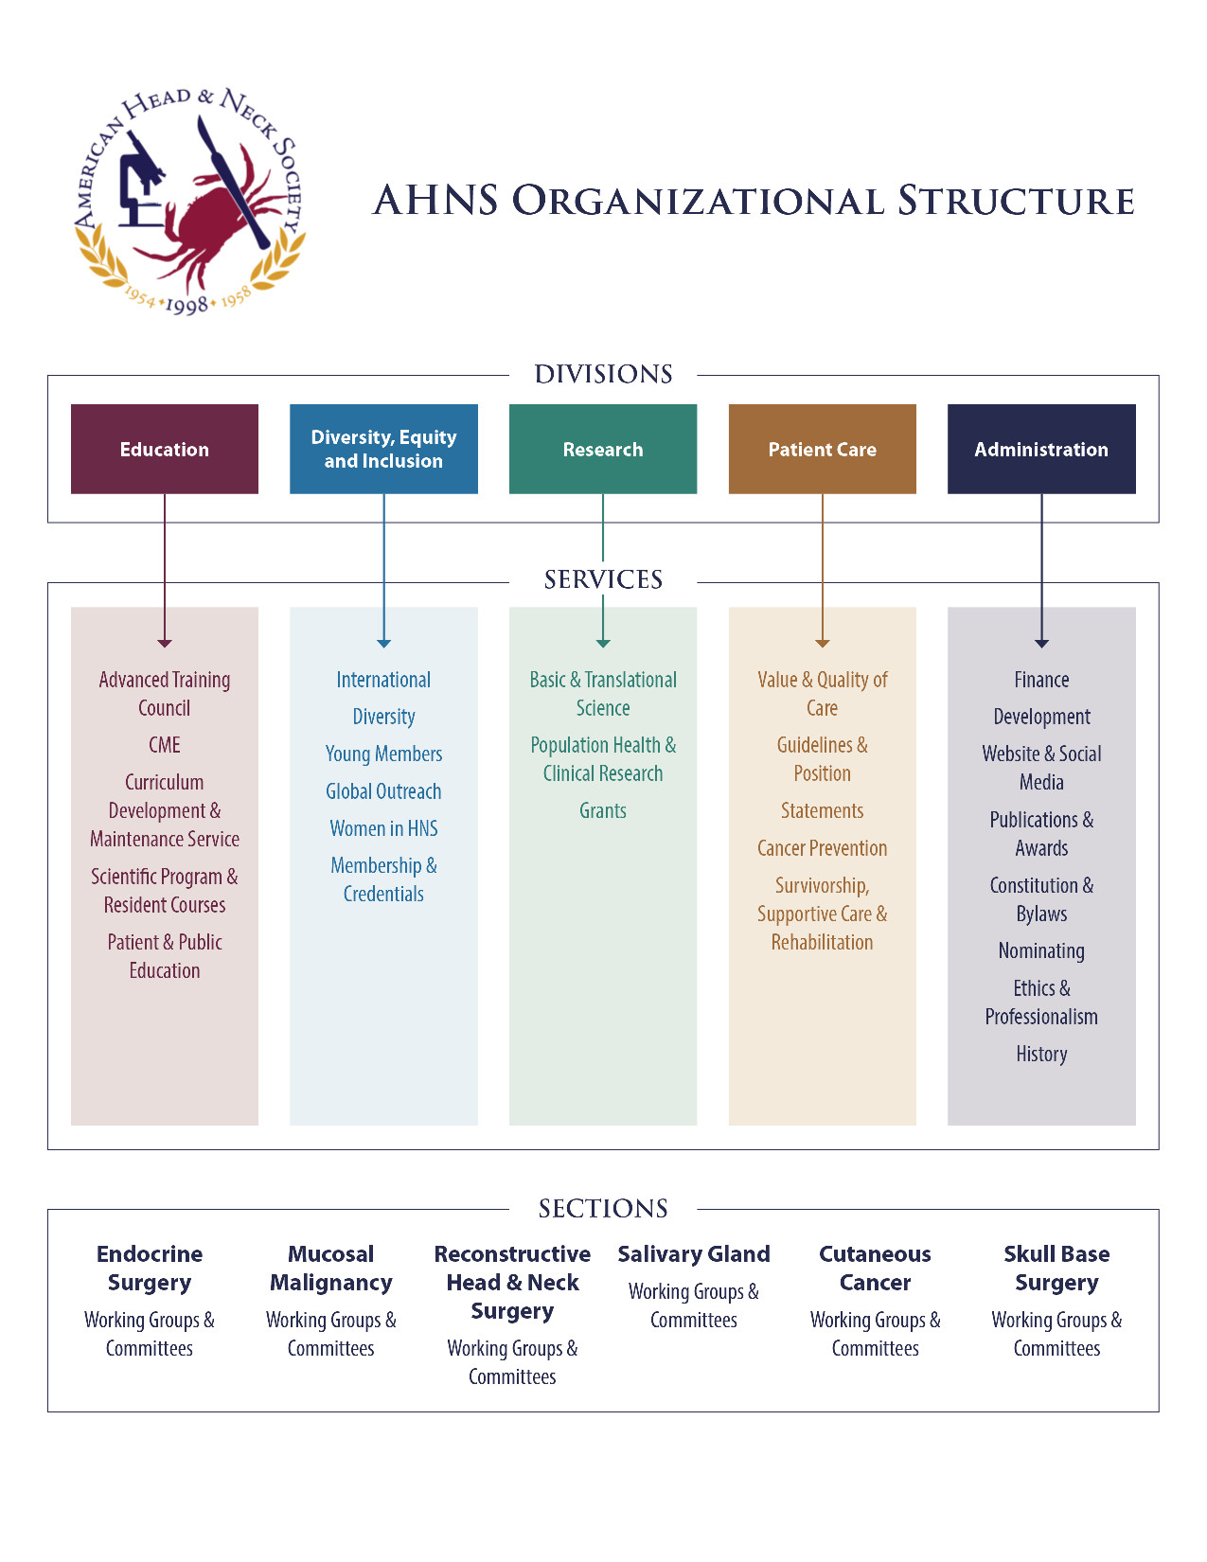
Secretary’s Report
2024 AHNS Business Meeting

Slide 8
President’s Report
2024 AHNS Business Meeting
Created and appointed three task forces to work on the mission of the Society. The task force names are:
Journal Task Force – Chairs – Bevan Yueh and Jose Zevallos
Fellowship Training – Chairs – Bill Lydiatt and Matt Old
Non-Otolaryngologist Participation in the AHNS – Chairs – Cherie-Ann Nathan and Dan Zandberg
Led leadership retreat during the Multidisciplinary Meeting in Phoenix
Helped initiate non meeting support revenue projects to assist in bringing in additional revenue streams.
Appointed keynote lectures for COSM:
Special Keynote: Norman Wolmark, MD
John Conley Lecture: Marty Makary, MD
Hayes Martin Lecture: Douglas Lowy, MD
Appointed Evan Graboyes as the Commission on Cancer Representative
Appointed Jose Zevallos as the 2026 AHNS International Conference Poster Chair
Spearheaded review of the management company current contract and oversaw RFP process

Slide 9
2024 AHNS SERVICE AWARD

Slide 10
DEI Division
Women in AHNS Service – Chairs Shirley Su and Karen Choi
Education Division
Advanced Training Council – Chairs Don Weed and Amy Hessel
Patient Care Division
AHNS Guidelines Advisory Board – Chairs Greg Randolph and Baran Sumer

Slide 11
Treasurer Report
Maie St. John, MD, PhD

Slide 12
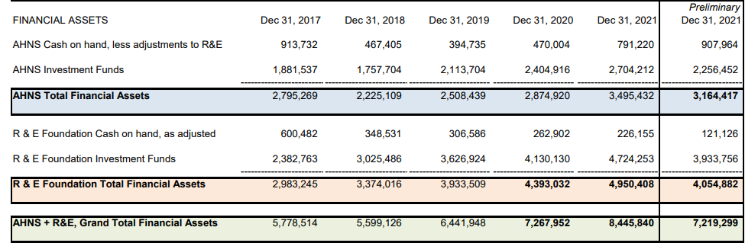
Financial Assets
2021-2022
(~14.5%)
2022 substantially > 2017, 2018, 2019
2022 ≈ 2020

Slide 13
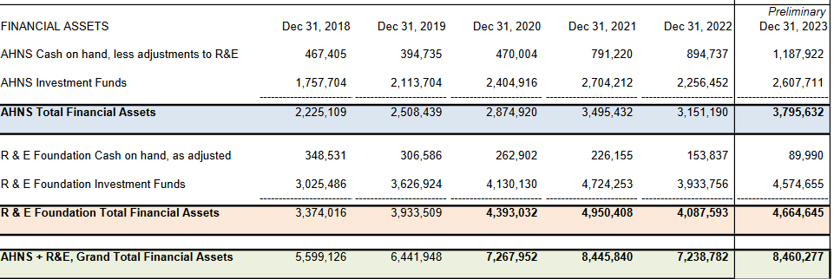
Financial Assets
+17% vs 2022

Slide 14
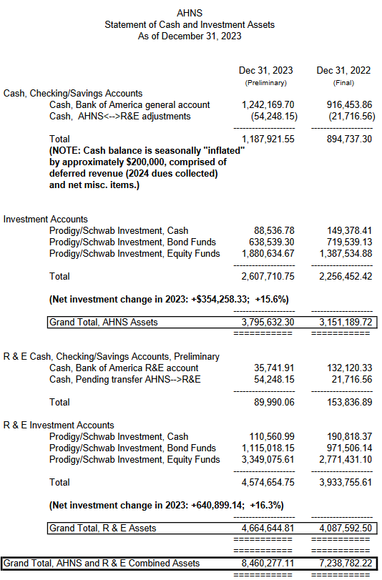
Significant increases during 2023
Investment Accounts showing positive change 2023

Slide 15
AHNS : R&E
Philosophies about AHNS and R&E Funding
AHNS: immediate operational expenses
Annual expenses to run society
Recommend up to 1.5 years cash on hand
R&E: investments in future of society
Transitioning from “accumulation” to using endowed funds
More aggressive growth in R&E investments
Mission-based budgets: research & educational support

Slide 16
AHNS Asset Allocation As of May 31, 2023

Slide 17
AHNS RE Asset Allocation As of May 31, 2023

Slide 18
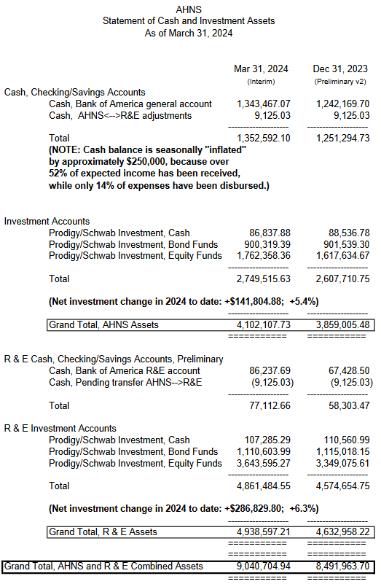
Significant increases in Q1 2024

Slide 19
Requests for Funding: Process
Requests for funding should be submitted in the form of a written proposal.
deadline for consideration is yearly on January 15th and July 15th
Proposal must include detailed budget (Budget Justification).
Proposal should include metrics and plans surrounding ROI.
Requests that span more than one time funding will need to include annual updates/ deliverables on the investment.
Include proposed models of permanence/sustainability.

Slide 20
We started managing the AHNS assets in January 2009 along with several other similar medical groups all associated with COIN. These groups all left Mellon when we took over management of their assets. Prodigy charges all of these groups the same .40% to manage their assets. AHNS and all the groups signed a management agreement when we started the relationship. Happy to discuss further or answer any other questions if helpful. Let me know.

Slide 21
Maie,
Bevan is broadly correct.
In response to your specific questions to me:
The combined cash and investments balances for the beginning and end of 2018 were:
AHNS beginning combined balance: $2,795,269 AHNS ending combined balance: $2,225,109
R&E beginning combined balance: $2,983,245 R&E ending combined balance: $3,374,016
The changes in 2018 beginning and ending cash/investments were affected by the transfers, and also by operating income and disbursements, and by net investment activity (gains/losses) during the year.
You also asked for a history of transfers going back a further 5 years (10 years total). However, there were not any transfers made during that earlier period of 2013 through 2017.
I hope this helps.

Slide 22
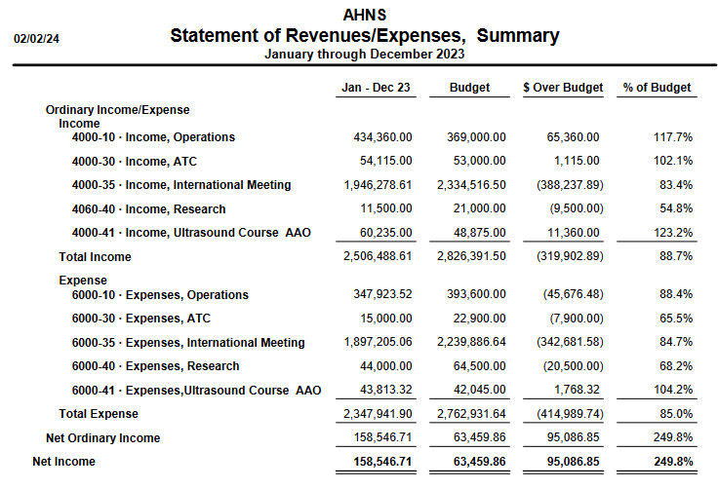
International Meeting
income and expenses
well below budget

Slide 23
2024 AHNS Business Meeting
Nominating Service Report
Brian Burkey, MD, MEd
Process this Year:
In an effort to be more transparent and to make sure we are giving more opportunities to more of our members, we created a self nomination process for several positions
There was great interest among our membership, and allowed the nominating service to see which members are most likely to become more actively engaged in leadership activities in the future

Slide 24
2024 – 2025 AHNS Leadership Slate
President: Bill Lydiatt, MD 2024-2025
President Elect: Bevan Yueh, MD 2024-2025
Vice President: *Eben Rosenthal, MD 2024-2025
Secretary: Susan McCammon, MD 2022-2025
Treasurer: Maie St. John, MD 2022-2025
Education Division Chair: *Babak Givi, MD 2024-2027
Education Division Vice-Chair: *Mike Moore, MD 2024-2027
Research Division Chair: *Stephen Lai, MD 2024-2027
Research Division Vice-Chair: *Nicole Schmitt, MD 2024-2027
Patient Care Division Chair: Gregory Farwell, MD 2022-2025
Patient Care Division Vice-Chair: Carole Fahkry, MD 2022-2025
Administration Division Chair: *Cecelia Schmalbach, MD 2024-2027
Administration Division Vice-Chair: *Lisa Shnayder, MD 2024-2027
DEI Division Chair: Amy Chen, MD 2022-2025
DEI Division Vice-Chair: Melonie Nance, MD 2022-2025
Foundation Chair: James Rocco, MD, PhD 2023-2026
Nominating Service: *Jeff Liu, MD 2024-2025
*Marilene Wang, MD 2024-2025
Finance Service: *Baran Sumer, MD 2024-2027
*Greg Kempl, MD 2024-2027
*Indicates who will be voted upon at the business meeting
2024 AHNS Business Meeting

Slide 25
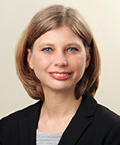
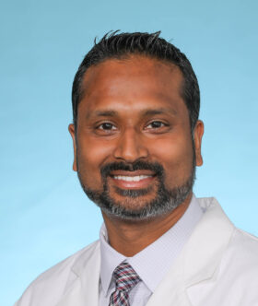
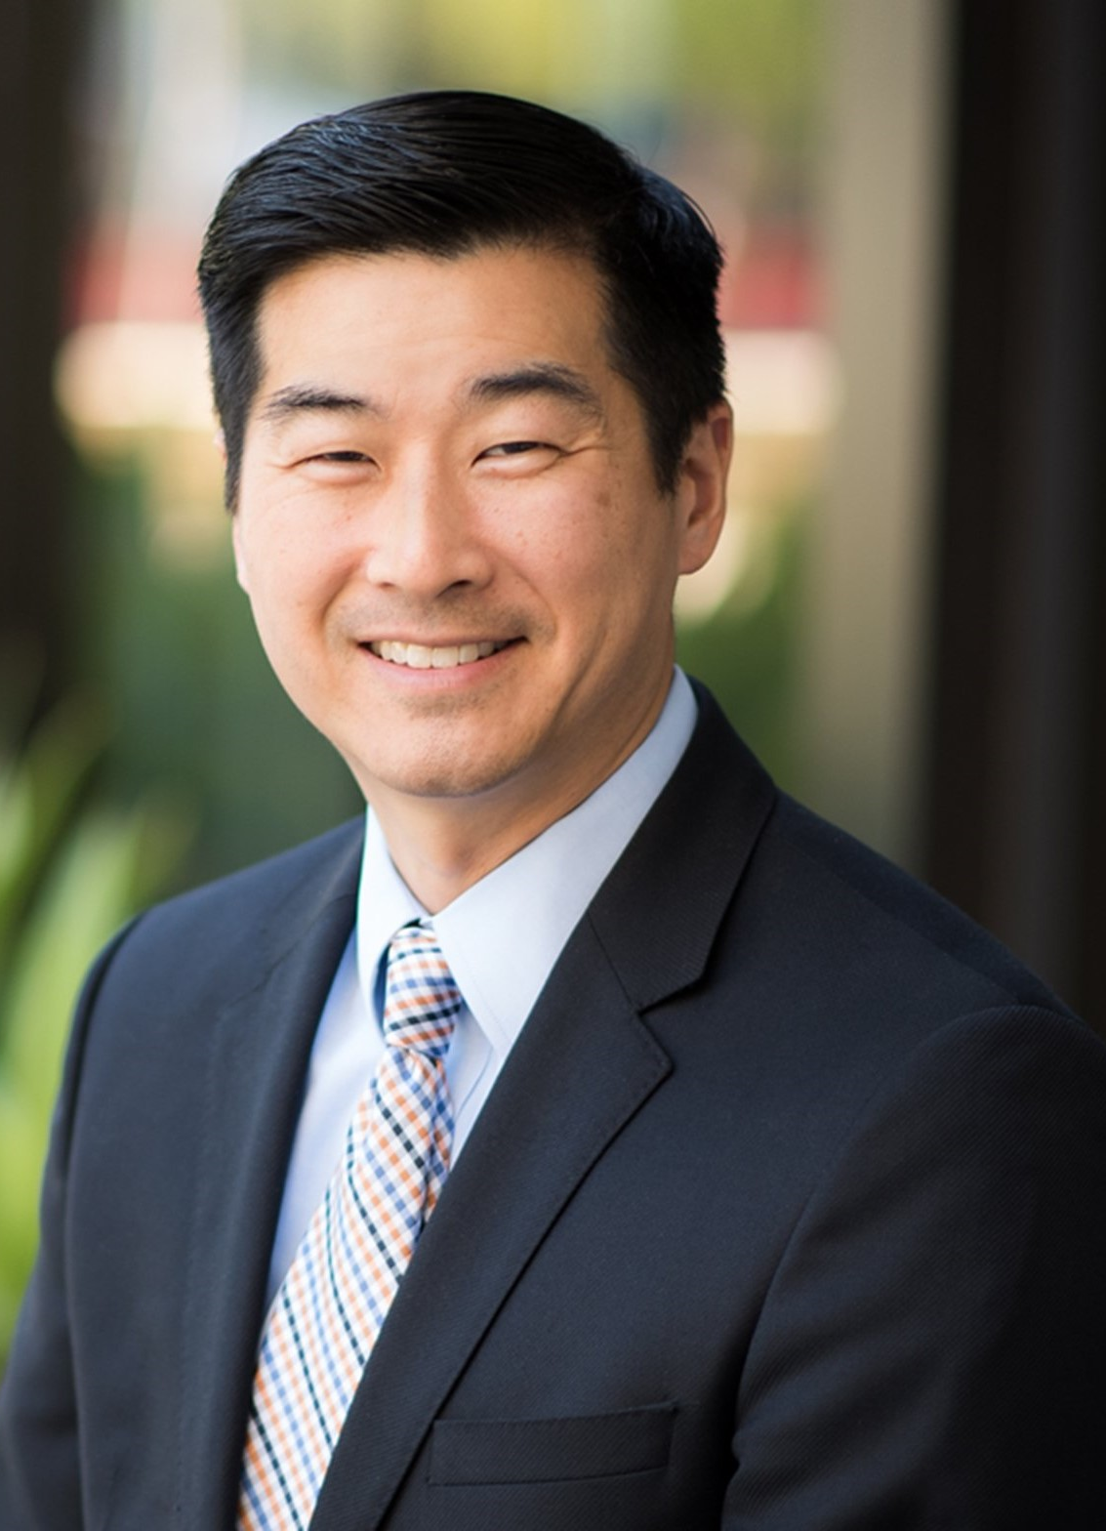
AHNS BUSINESS MEETING 2024
Nikki Schmitt
Emory University
Sid Puram
Washington U, St Louis
Patrick Ha
UCSF

Slide 26
AHNS 2024 Meeting
Sessions
3 pre-meeting courses:
Thyroid ultrasound
Head and Neck Reconstructive Course
Innovation and Entrepreneurship Symposium
20 panels/debate sessions plus 1 Joint Panel with ARS
Added top scoring abstract submissions into panels
4 scientific sessions, awards now for top oral presentations (Corlas award)
3 keynote addresses
Distinguished Keynote – Dr. Norman Wolmark
John Conley Keynote – Dr. Marty Makary
Hayes Martin Keynote – Dr. Douglas Lowy

Slide 27
AHNS 2024 Meeting
Registration
491 registrants as of 5/14/24
Development
$135,500 total (goal $115,000)
Planning committee, included multidisciplinary team members
Abstracts
640 total submissions
37 Oral Abstract Presentations
178 Poster Abstract Presentations

Slide 28
AHNS ADMINISTRATION DIVISION

Slide 29
AHNS BUSINESS MEETING 2024 Administrative Division
Ethics and Professionalism Service
Shuman and Langerman
- Developed, piloted and established AHNS peer support network (special accolades to Drs. Langerman and Colaianni)
- Reviewed and updated AHNS COI policy and conflict mitigation approach
- Liaised with Surgical Ethics Affinity group for American Society of Bioethics and Humanities on upcoming shared programming

Slide 30
AHNS BUSINESS MEETING 2024 AWARDS AND PUBLICATION SERVICE
15 manuscripts
Robert Maxwell Byers Award: Assessment of Social Vulnerability in Laryngeal Cancer Prognosis and Treatment in the United States
Randal Weber: Using Artificial Intelligence to automate the extraction of staging criteria from the electronic health records of oropharyngeal cancer patients.
Resident Basic Science Research: Characterization of the Primary Tumor-Sentinel Node ImmunoMigratome Demonstrates a Key Role for Dendritic Cell Trafficking in the Successful Response to Immunoradiotherapy.
Resident Clinical Paper Social Determinants of Health in Donor Site Morbidity in Head and Neck Cancer Reconstructive Limbs: Anterolateral Thigh and Fibula Free Tissue Transfers.
Prevention and Early Detection Award: Prevalence and Predictive Factors for HPV Vaccination Among Older Adults in the United States
Miriam Lango, MD - Chair
Antoine Eskander MD – Vice Chair
-Tony Eskander will take over Chair
-Valuable contributions from Raymond Chai and Sid Puram
-Effective working relationship with Samir Khariwala JAMA Oto; formal reviews or commentary for manuscripts under consideration for simultaneous publication with the annual meeting
-International meeting 2023-68 submissions

Slide 31
AHNS BUSINESS MEETING 2024
Fundraising Goal for 2024 Annual Meeting = $115,000
Total raised = $135,500
Educational grant support = $125,500
Marketing support - $10,000
TORS Fellows course held January 25 and 26 at Intuitive’s Atlanta Lab
Plans underway for 2025
Non-Meeting Opportunities
Approved in March by leadership
Item of highest interest is Industry webinars
Interested companies are Intuitive Surgical, J & J, Rakuten

Slide 32
AHNS COUNCIL MEETING 2024 Administrative Division
AHNS Website & Social Media Service
Badhey and Sumer
-Streamlined Find a Doc Page and the AHNS website admin to update and upgrade the website to stay modern, pending an overhaul in the coming year
-Continued routine posts and communication of the multi pronged social media campaigns (facebook, instagram, twitter, website/emails)
-Multiple services involved in contributing new and exciting content including introduction of short videos this year
Upcoming Plans:
- AHNS position paper approved and in the manuscript phase (Position statement on Utilization of Social Media within a Head and Neck Oncologic Practice)
- Planning for additional 'take overs' of instagram during the upcoming spring meeting in Chicago
- Motivate rising fellows to get involved in the service
-Workers of note Patrick Morgan and Caitlin McMullen

Slide 33
AHNS COUNCIL MEETING 2024 Administrative Division
History Service Report
Nance and Goodman
- ANHS 2024: personal one question interview spots about “Your most memorable AHNS meeting?” To compile in a small webcast/short video.
- History Service Quiz for COSM that will also be on the meeting App.
- AHNS History YouTube channel - https://www.youtube.com/watch?v=Hu18KVDPVkQ
Working on:
- PROPOSAL FOR PANEL OR PRESENTATION OR POSTERS A panel, “History of Disruptive Redevelopment,” or “History of Disruptors,” “History Innovators,” “History of Women in HNS combined with AHNS History Disruptors” Women HNS, Hispanic HNS, Black HNS
--RECRUITMENT OF NEW MEMBERS, STUDENT INVOLVEMENT
--VISUAL/DIGITAL IMAGE HISTORY Wikipedia model where AHNS members can contribute to the content.

Slide 34
AHNS COUNCIL MEETING 2024 Administrative Division
Constitution/Bylaws Service
Civantos
No bylaws changes this year.

Slide 35
AHNS DIVERSITY, EQUITY AND INCLUSION DIVISION

Slide 36
AHNS BUSINESS MEETING 2024 – Membership/Credentials Service
Total Membership is stable
# of Members 1904 (2023) to 1900 (2024) to date
Active Member Dues received has decreased slightly
Dues Received: 75% of dues paid in 2023; 73% of dues paid in 2024 to date
Dues increase brings in additional revenue
2023 Paid Members- 1055 ($272,075): 2024 Paid Members-1085 ($344,925)
Active Membership remains stable
824 (2022) to 850 (2023) to 851 (2024)
Medical student category has biggest increase
64 members in 2023, 93 members in 2024
Demographics
Male : Female ratio—(569:163 for Active, 224:125 for Resident/medical students)
Race/ethnicity data known for 43% of members, steady increase in collection
Project to increase # of Resident members upgrading to Active Fellows
Induction of New Members in Chicago -104 new members
6 Active Fellows | 9 Associate | 15 International | 31 Medical Students | 43 Residents

Slide 37
AHNS BUSINESS MEETING 2024 - DIVERSITY SERVICE
Gina Jefferson, MD Chair Tammara Watts, MD, PhD Vice-Chair
Inaugural AHNS Dr. Eddie Méndez Fellowship Award 2024 had 6 total applicants.
2024 winner Julian Jackson - Sidney Kimmel Medical School - Research title, “The Potential of Gasdermin E and Ninjurin1 in Immunogenic Cell Death (ICD) for Head and Neck Squamous Cell Carcinoma".
Research Mentors: Dr. Joseph Curry and Dr. Punam Thakkar at Thomas Jefferson.
7th AHNS Myers’ Family Summer Travel Fellowship in Otolaryngology - for under-represented minority medical students had 13 applicants.
2024 winner Gabrianna Andrews - Rowan-Virtua School of Osteopathic Medicine (RowanSOM) home institution does not have an Otolaryngology department.
Chosen fellowship site with Dr. Jeffrey Myers at MD Anderson.
2023 marked 1st year the AHNS Myers’ awardee (2022) presented work at the Award Ceremony
2023 recipient Laura Jackson, will present her entitled work, “DCLK1-Mediated Regulation of Invado-
podia Dynamics and Matrix Metalloproteinase Trafficking Drives Invasive Progression in HNSCC”.
Research Mentors: Dr. Lisa Shnayder and HN group at Univ. of Kansas.
*Join Us at the AHNS Award Ceremony - Thursday, May 16, 2024, at 7:00 AM ET Room Grand Ballroom EF*

Slide 38
AHNS BUSINESS MEETING 2024 WOMEN IN AHNS SERVICE – CHAIRS SHIRLEY SU AND KAREN CHOI
Margaret Butler Award: (Amy Lassig, MD & Larissa Sweeney, MD)
Congratulations to the Margaret Butler Awardee: Dr. Carol Bradford
2023: Anna Pou, MD
2022: Amy Chen, MD
2021 Margaret Butler Awardee: Lisa Orloff, MD
2020: Cherie Ann Nathan, MD; 2019: Marion Couch, MD PhD MBA
Panel: How to Build Impactful Programs – Wednesday at 4pm
Future initiatives:
Podcast
Mentorship Program
Womens Workshop
Forum on web site
Survey on disparities

Slide 39
AHNS BUSINESS MEETING 2024 – YOUNG MEMBERS SERVICE
Chair: Vivian Wu, MD
Vice Chair: Andrés Bur, MD
Solicitation for Vice Chair - Chairs requested Service members to reply to an email asking for self-nominees for Vice-Chair.
COSM2024 - In person meeting planned.
Podcast, AHNS Young Members Corner – 8 Total.
o Young Members created 3 more Podcasts Drs. Lydiatt, Shuman, Malloy, they finalized editing and will release one a month leading up to COSM 2024.
o We have spread the word via AHNS Blog, Social Media X, Facebook, Instagram, mass email to AHNS general interest group which has 12,883 active subscribers, and publication in JAMA Oto website.
AHNS Fellows Qualitative Study Guide Update:
o Data collection complete.
o Data analysis complete.
o Collating themes to write discussion.
o Expected submission for review end of March 2024.
Collaboration with International Fellows Initiative, “Exploratory Analysis of Head and Neck Surgical Oncology Fellow Perspectives of American”.
New business:
o Quarterly zoom with midcareer folks –casual conversation:
Endocrine practice
Cutaneous practice
Industry involvement
HPV vaccine
Managing your practice and your partners – OR time, how to optimize APP, best way to incorporate supportive oncology.

Slide 40
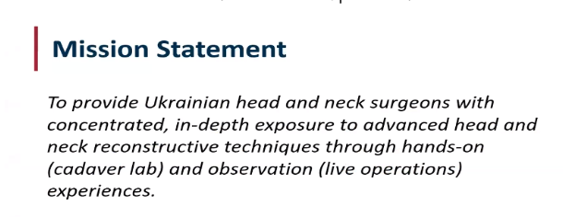
AHNS BUSINESS MEETING 2024 – Global Outreach Service
Chair: Samir Khariwala
Vice Chair : Pankaj Chaturvedi
AAFPRS initiative called Operation Ukraine -
Dr. Rusha Patel and Dr. Mark Mims, continuing to support.
Pre COSM2024 Global Outreach Webinar (Completed 5/12/2024)
“Implementing Standardized Care and New Technologies for Head and Neck Cancer in Under-Resourced"
Erivelto Volpi, MD from Brazil, ”Implementation of minimally invasive techniques for thyroid nodules in under-resourced areas”
Prathamesh Pai, MD from India, “Maintaining treatment standards in under-resourced settings”ds
Luiz Kowalski, MD from Brazil, ”Developing survivorship and rehab programs in under-resourced settings”
Deepa Nair, MD from India, “Neoadjuvant therapy for advanced oral cancers”
Upcoming:
Webinars
Quarterly zoom/webinars with
Proposal for Ethiopia Fellow
Continuing to seek additional funding outside AHNS

Slide 41
AHNS BUSINESS MEETING 2024 – International Advisory Service
Chair: Erivelto Volpi
Vice Chair: Wotjek Mydlaz and Vincent van der Poorten
Completed 2 calls
Including the AHNS Section, Research Division, and ATC Fellows so that more people are aware of IAS and how we can collaborate bidirectionally and do projects with AHNS international members.
Upcoming Plans:
IAS newsletter 3-4 annual issues, including content from all AHNS Sections.
Co-Branded Webinars and Virtual Tumor Board
Quarterly Zoom/webinars with global regional and sister societies
Global research initiative meeting Dr. Stephen Lai, Chair AHNS Research Division – what global collaborative options exist for the AHNS and the IAS
International Fellows initiatives
IFI Dr. Omar Karadaghy subgroup in IAS networking event, and 2 webinars a year
Business/Next meeting in person and virtual IAS at
COSM or International Meeting:
Organize local interest group mixers or coffee meetings
during international conferences to facilitate networking and collaboration among attendees.
Coordinate with the fellow’s group to foster friendships and mentorship opportunities, serving as a catalyst for future collaborations.

Slide 42
AHNS EDUCATION DIVISION

Slide 43
Head and Neck US Course
2024 AHNS Business Meeting
ACS Exported course: Thyroid, Parathyroid and Neck US
Discontinued by AAOHNSF Edu Division
AHNS new home
- Offered at AHNS 2019
- Run by AHNS at AAOHNSF 2023- profit
Offering in 2025 in New Orleans as qn AHNS product
-Fellow curriculum
-Certificate of Participation
Notes:
Has been th exported acs ciuyrse

Slide 44
Webinar Process
2024 AHNS Business Meeting
New Guidelines developed 2022
-Activity Planning Worksheet
-ABMS/MOC competencies
-Audience, Topic, Format, Faculty, Representation, Timing, Timeline
Twice a month
Tumor boards twice a month
Notes:
Minimize overlap with tumor boards

Slide 45
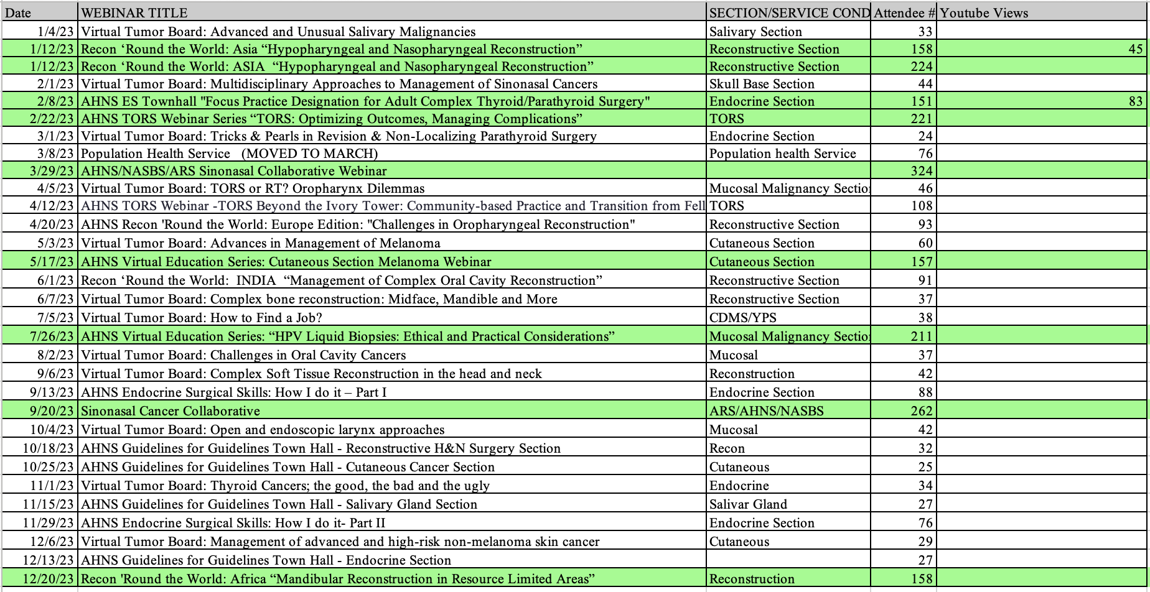
2023
2024 AHNS Business Meeting
Notes:
Minimize overlap with tumor boards

Slide 46
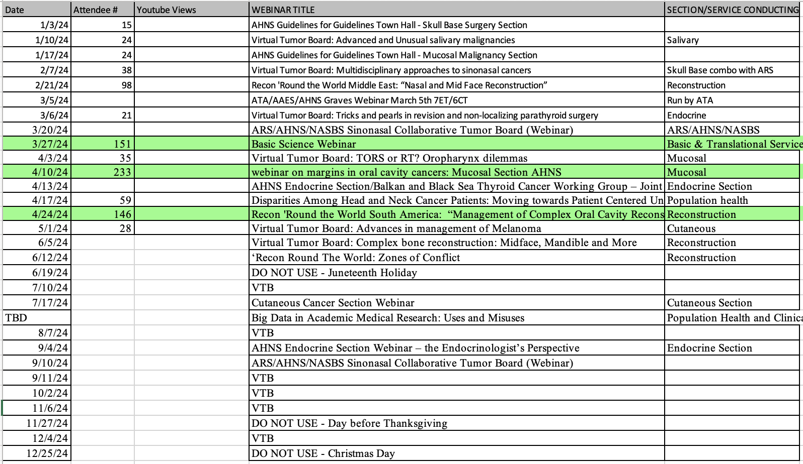
2024
2024 AHNS Business Meeting
Notes:
Minimize overlap with tumor boards

Slide 47
Top You Tube Views
2024 AHNS Business Meeting
Notes:
Minimize overlap with tumor boards

Slide 48
Advanced Training Council
2024 AHNS Business Meeting
2 new Head and Neck Fellowships approved – Baylor University, Sarah Cannon
11 Re-accreditation Site Visits completed this year
9 Programs Re-Accredited (+2 pending review)
5 new Program Directors approved – University of Pittsburgh, University of Washington, Cleveland Clinic, Henry Ford Health, University of Oklahoma
New AHNS-built Case Log System launched for FY2023

Slide 49
Advanced Training Council
2024 AHNS Business Meeting
Upcoming Re-Accreditation Site Visits
Mass Eye & Ear
Mass Eye & Ear – Endocrine
UT Southwestern Medical Center
University of Alberta Hospital
Thomas Jefferson University
Roswell Park Cancer Institute
Indiana University School of Medicine
Emory University
Loma Linda University
Nebraska Methodist Hospital

Slide 50
Advanced Training Council
2024 AHNS Business Meeting
Upcoming New Program Accreditation Site Visits
Tulane University – Endocrine
University of Nevada – Las Vegas
University of Southern California
Mayo Clinic Rochester

Slide 51
Advanced Training Council
2024 AHNS Business Meeting
Task Groups working on 4 projects within ATC:
Key Indicator cases with minimum case numbers
Program’s Evaluation of Fellows form and Fellow Final Evaluation Portfolio requirements
Revised Accreditation Site Visit form
ATC website subdomain upgrade with real-time program information, update capability, ATC communications with program, fellows, etc.
ATC collaboration with CDMS:
Fellow evaluation form and Fellow self-assessment tools
Fellow tumor board participation

Slide 52
Curriculum Development and Maintenance Service
2024 AHNS Business Meeting
Developed a calendar for utilization of the Standardized Fellowship Curriculum for rollout July 2024
Plan for rollout of self-assessment through Dosed Daily Tracking progress:
-Completion of self-assessment questions
-Virtual tumor board attendance
-Fellow and PD attestation

Slide 53
AHNS BUSINESS MEETING 2024 – CME Service
Chair: Ric Carrau, MD; Vice-Chair: Katie Fedder, MD
2023 Meeting Evaluations
724 respondents to immediate post-activity survey; 36 respondents to 3-month follow-up survey
Many requests for access to recordings/content
Individual intent to change statements were varied and specific; overall rating was 98% good/excellent. “best meeting I've attended in a decade.”
2024 Meeting
All Disclosures Reviewed and Mitigated
4 sessions need to be monitored
4 session chairs have agreed to draft summaries of their sessions to send to registrants after the meeting

Slide 54
AHNS BUSINESS MEETING 2024 – CME Service
Chair: Ric Carrau, MD; Vice-Chair: Katie Fedder, MD
3. ACCME Reaccreditation
Application due March 2025 -> November 2025 decision
Committee will need some involvement in Fall 2024 and Winter 2025
Anticipate applying for Commendation

Slide 55
AHNS BUSINESS MEETING 2024
Patient & Public Education Service
Goals for 2024/2025
Review and revise all patient information on AHNS.info -- Survey membership on use of patient information
Draft a Position statement on AI as a source of Patient Information

Slide 56
AHNS PATIENT CARE DIVISION

Slide 57
AHNS BUSINESS MEETING 2024
AHNS GUIDELINES ADVISORY BOARD (AGAB)
Townhalls to all 6 AHNS Sections (Mucosal, Endocrine, Skull base, Reconstruction, Cutaneous, Salivary) to communicate the new pathway and opportunities to AHNS members have been completed as of 2/2024
Budget for the CCS and CPG approved by the Executive Council
Have two applications one for a CCS and one for a CPG
Five narrative reviews or position papers submitted and approved by AGAB and presubmission inquiries sent to journals.

Slide 58
AHNS BUSINESS MEETING 2024
Cancer Prevention and Early Detection Service
Head and neck self-exam website – Officially launched in April. Focus group with HNCA ambassadors complete, additional edits forthcoming from their feedback. CPS to discuss methods for promotion at AHNS meeting.
Tobacco cessation – Grant application submitted for TSET Health Promotion Research Center for survey on practice patterns and identification of knowledge gaps, Rusha Patel, Andrew Day, Jo-Lawrence Bigcas and others involved. Plan for survey distribution to follow, long-term goal to provide education on tobacco cessation counseling and prescribing for surgeons
Oral leukoplakia – Narrative review on oral premalignant lesions drafted, one-page approved by AGAB, Jimmy Gates, Lisa Shnayder, Marianne Abouyared, Mike Moore, Andrew Day, Greg Fawell, and others involved, collaboration with mucosal section. Planning manuscript submission in May-June.

Slide 59
AHNS BUSINESS MEETING 2024
Cancer Prevention and Early Detection Service
Head and neck cancer awareness week – 5 award recipients granted $1000 for April’s awareness week, chosen by CPS
AHNS journal club – CPS themed journal club articles chosen, reviews being completed, Elizabeth Blair, John Cramer, Andrea Ziegler, Varun Vendra, Tony Richa and others involved.
PREVENT HPV Cancers Act of 2023" (H.R. 3633) – Andrew Katz and John Cramer developed education for distribution to AHNS membership about this act that AHNS has co-sponsored.
HPV Patient-facing slide deck – Final draft of content to be reviewed at upcoming AHNS meeting. James Hamilton, Samer Al-Khudari and others involved.

Slide 60
AHNS BUSINESS MEETING 2024
Survivorship/ Supportive Care/ Rehabilitation Service
Webinars:
May– Head and Neck Cancer: What To Expect the First Year.
June– Guiding Light: Navigating End-of-Life Care for Head and Neck Cancer Patients
August – Laryngectomy webinar.
October 5 Survivorship Symposium – In Philly.

Slide 61
AHNS BUSINESS MEETING 2024
Value and Quality of Care Service
Focused on 3 areas this past year
Post-op Radiation Delays – pursuing collaboration with ASTRO to address the issue with the Radiation Oncology community
Patient engagement – designing patient survey to understand how they interact with PROs and what things they find valuable when reporting on their outcomes; goal is to produce best practice guidelines for organization trying to implement or optimize PROs in their practices
Multidisciplinary tumor boards – working to establish minimum requirements for a multidisciplinary tumor board to have guidelines particularly for the non-academic setting

Slide 62
Research Division
Population Health & Clinical Research Service
Basic & Translational Science Service
Grants Service

Slide 63
AHNS BUSINESS MEETING 2024
Population Health & Clinical Research Service
Reviewed and sponsored an AHNS survey
Developed monthly infographics (6-8 in the past year)
Presented Disparities in Research Webinar
Five-Minute Interview Series: 2 completed by Joseph Curry
featuring Nabil Saba and Sana Karam
AHNS Journal Club Edition
1 panel and 1 instructional course at the ANHS Meeting in Montreal
Barry Wenig
Joseph Curry
Staff: Loren Hamilton
Notes:
Developed monthly infographics (6-8 in the past year) with more planned
Five-Minute Interview Series: 2 completed by Joseph Curry featuring Nabil Saba and Sana Karam with several more in the works

Slide 64
AHNS BUSINESS MEETING 2024
Barry Wenig
Joseph Curry
Staff: Loren Hamilton
Population Health & Clinical Research Service
Ongoing multi-institutional COVID-19 Cancer project
Upcoming proposed webinars on Population Health
and Big Data
Proposed Collaborative webinar on Research Ethics with the
Basic & Translational Science Service
Development of a Service Slack channel
Notes:
Developed monthly infographics (6-8 in the past year) with more planned

Slide 65
AHNS BUSINESS MEETING 2024
Jeffrey Liu
Sufi Thomas
Staff: Loren Hamilton
Basic & Translational Science Service
Launched the Virtual Repository
Tweeted Infographics (ctDNA , p16 in HNC, Debio)
Organized the first BST webinar: Immunotherapy for Mucosal HNC - Discussion of the Current Landscape and Visions for the Future
Conducted a survey to better understand the needs of Basic Scientists to encourage membership and participation in AHNS activities.

Slide 66
AHNS BUSINESS MEETING 2024
Grants Service
Developed a new mechanism for the AHNS Presidential Grants
The new AHNS President is given the option to select one of the three RFAs for a three-year period.
This year, one of the three will cycle off and the new president will select a new RFA.
The Grant’s Service is currently preparing potential topic suggestions.
Inaugural Innovation and Entrepreneurship Symposium
Major initiative for this year - development and implementation
held on May 14, 2024 in Chicago (COSM/AHNS)
First-of-its-kind course led by Dr. Jose Zevallos and Dr. Baran Sumer.
Includes surgeon inventors and entrepreneurs from across the United States, as well as venture capitalist, start-up CEOs, experts in technology transfer, and experts in intellectual property.
Jose Zevallos
Steven Chinn
Staff: Loren Hamilton

Slide 67
2024 CORE Study Section: AHNS Grant Awards
Thank you to the AHNS reviewers for CORE!
Theresa Guo, M.D.
Catherine Haring, M.D.
Thomas Ow, M.D.
Travis Schrank, M.D., Ph.D.
Andrew Shuman, M.D.
Natalie Silver, M.D.
Carissa Thomas, M.D., Ph.D.
Michael Topf, M.D.

Slide 68
2024 CORE Study Section: AHNS Grant Awards
7 grants totaling $100K
AHNS/AAO-HNSF Translational Innovator Award ($100,000 total)
AHNS/AAO-HNSF Young Investigator Research Development Award ($50,000 total)
AHNS Presidential Award: Best Practices for Treating Head and Neck Cancer in
Non-academic and Rural Communities ($10,000)
Anticipated non-obligated funds
Year 1 $70K
Year 2 $90K

Slide 69
AHNS BUSINESS MEETING 2024
Cutaneous Cancer Section
Section Leadership Transitions—Election Results
Chair: Steven Wang → TJ Ow
Vice-Chair: TJ Ow → Karen Choi
Past-Chair: Cecelia Schmalbach → Steven Wang
Section Service Chairs
Education: OPEN Research: OPEN
Social Media: Caitlin McMullen CDMS rep: Alice Lin
Program Liaison: Neil Gross Program Chair: Daniel Knott
Membership: Vivian Wu Cancer Prevention: Jessica Yesensky
Departing Section Leaders – Thank you!
Brian Moore (Program Co-Chair), Kevin Emerick (Research)

Slide 70
AHNS BUSINESS MEETING 2024
Cutaneous Cancer Section
Section Highlights 2023-2024
Webinar: Merkel Cell Carcinoma July 17 – Karen Choi
Social Media (Caitlin McMullen): Twitter and Instagram posts
Monthly Blog articles (Caitlin McMullen)
Research Update: SLNB for cutaneous SCC—Kevin Emerick; Standardized Pathology Report for cutaneous SCC—TJ Ow
Neck Dissection Classification Update (Section reps: Caitlin McMullen, Vivian Wu)
May is Skin Cancer Awareness Month
CDMS—Tumor Board topic: Melanoma
Journal Club
Weekly Instagram postings (Jessica Yesensky)

Slide 71
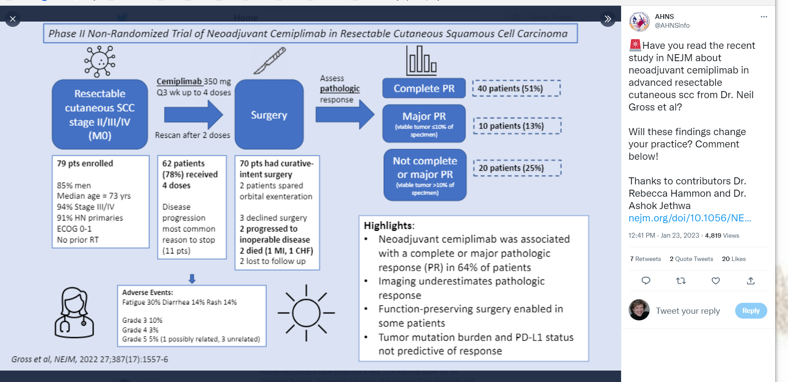
Cutaneous Cancer Section on

Slide 72
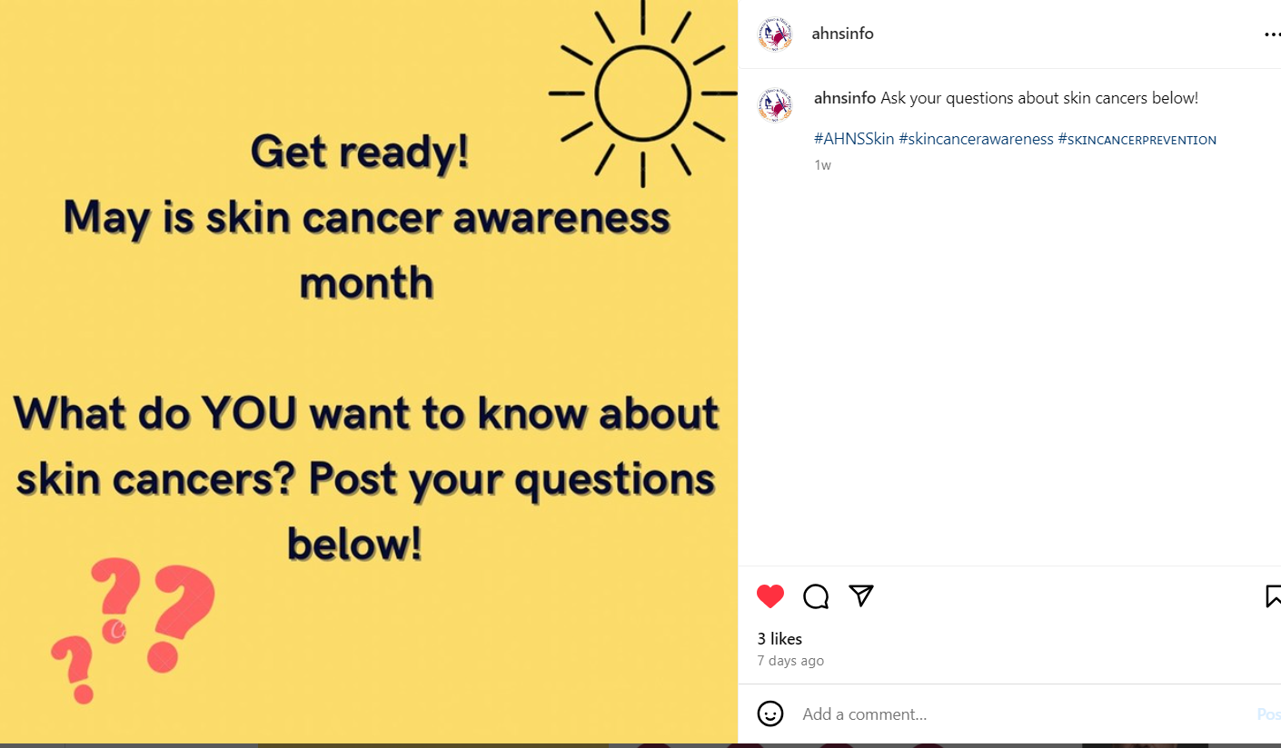
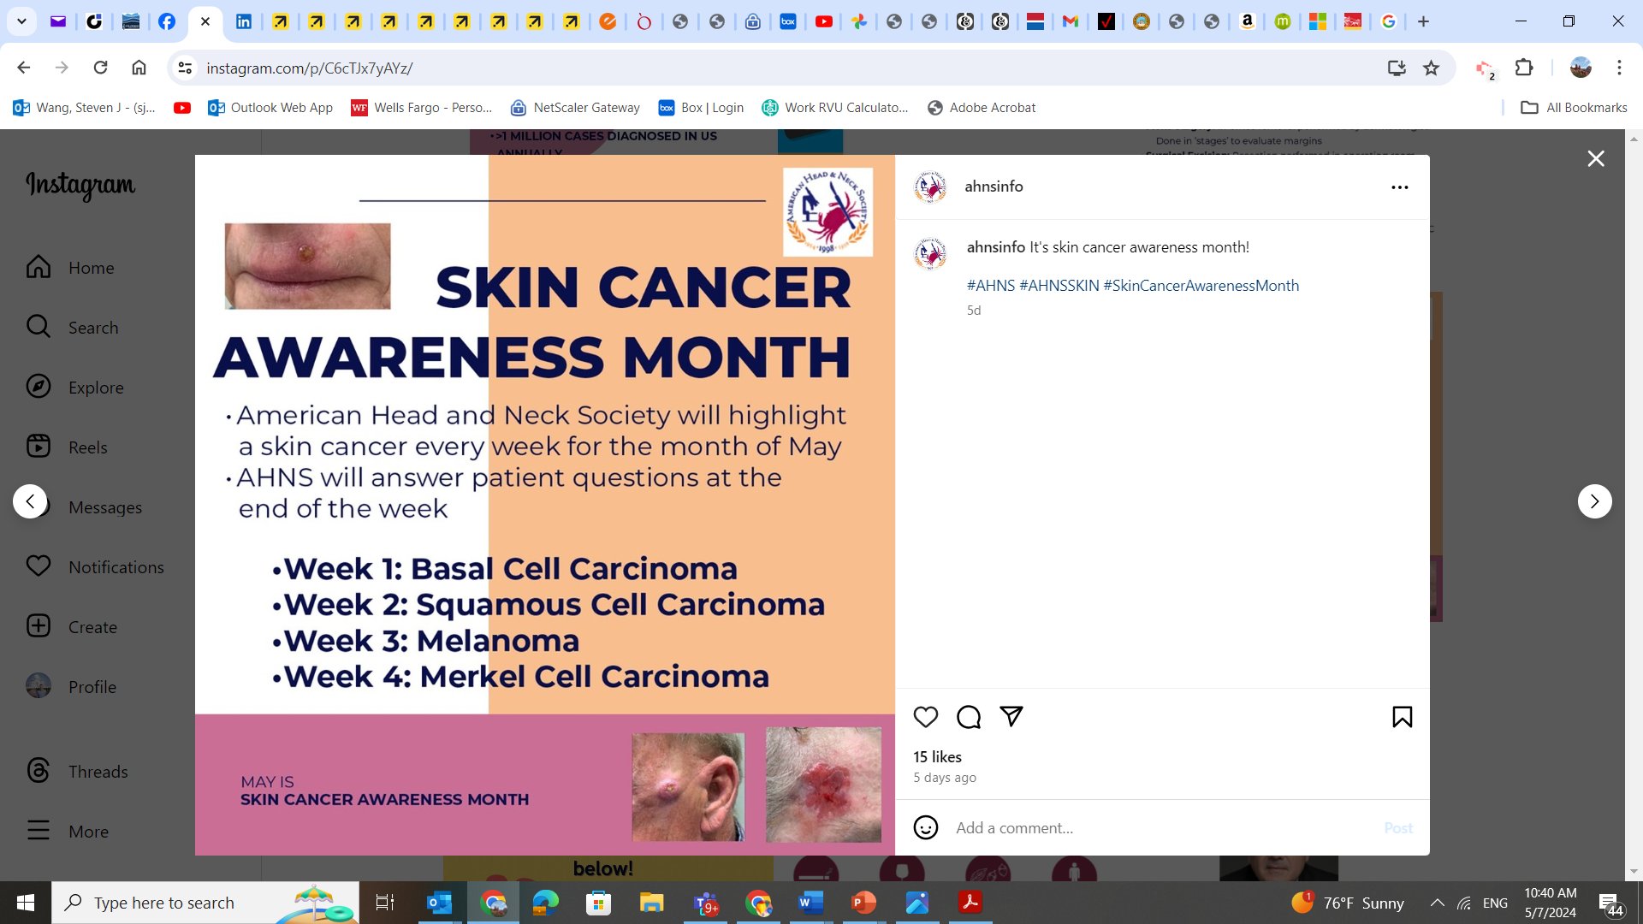
Cutaneous Cancer Section on

Slide 73
AHNS BUSINESS MEETING 2024 – Endocrine Section
Dr. Stack finishes his term as Chair (2021-2024) and will be replaced by Dr. Michael Singer (Co-Chair 2021-2024) along with Dr. Marika Russell as incoming Co-Chair for 2024-2026.
2023 had robust activity in webinars, a 6 hour course and a 2 hour “hands on” event with device manufacturers at the International Meeting, and ongoing production of publications.
Section communications with regular quarterly newsletters have improved through implementation of a SLACK channel (ahnsendocrinesection.slack.com).
The section continued to monitor, publicize, and contribute to the ABS/ABOHNS Focus Practice Designation (FPD) in Complex Adult Thyroid/Parathyroid Surgery.
The section worked with AAOHNS and other groups to survey thyroid ablation work and prepare presentation to the RUC (CMMS). Valuations anticipated fall 2024.
The section is involved in re-creating a head and neck ultrasound certifying course within AHNS upon its dissolution by ACS. Acknowledge Drs. Russ Smith and Lisa Orloff.
Section leadership has consolidated from a board and committee structure to a defined leadership “bench” with an outreach/succession plan and preservation of “best practices”.
Dr. Braimah, Nigeria, will be hosted by the ES and Dr. Agrawal of the U. Chicago as the 2024 International Female Surgeon Visiting Head and Neck Surgeon Scholar.

Slide 74
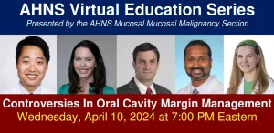
AHNS BUSINESS MEETING 2024: Mucosal Malignancy Section of AHNS
Webinars:
HPV Liquid Bx (with Ethics and Professionalism Service), 07.26.23,
Oral Cavity Margins, 04.10.24,
TORS: Optimizing outcomes, managing complications, 11.29.23,
TORS: Beyond the Ivory Tower, transition from Fellowship, 12.2.23
Journal Club: HPV-related OPX SCCA February 2024
Virtual Tumor Boards:
August 2, 2023 – Challenges in Oral Cavity Cancers (Mucosal Section)
October 4, 2023 – Open & Endoscopic Larynx Approaches (Mucosal Section)
April 3, 2024 – TORS or RT? Oropharynx Dilemmas (Mucosal Section)
TORS AHNS course for Fellows 01.25-26, 2024: (Jackson, Holsinger, Gross, Van Abel): Atlanta; 40 fellow participants
Value/Quality of Care (Divi/Aslam): radiation delays, PRO surveys, components of the tumor board
White paper proposal submissions:
Oral Cavity Cancer treatment and reconstruction CPG (Clinical Practice Guideline), with Recon Section (Lango, Shnayder, Old, Richmon)
White lesions of the Oral Cavity; Narrative Review, with Prevention Service (Holcomb, Gates)
Neck Dissection Position Paper: Multi-Section (Robbins, Lane, Lango)
TORS Surgical Resection Margins, Pathologic Processing and Adjuvant Therapy Implications; Clinical Consensus Statement (CCS) (de Almeida et al.)

Slide 75
TORS Task Force: Leadership & Organization
Three co-chairs mirroring the “Divisions” of the AHNS v2.0
Gross: Education
Van Abel: Research
Holsinger: Patient Care
Quarterly Virtual Meeting of the Task Force
Recruitment and Expansion of membership
BUILD OUT THE TEAM

Slide 76
AHNS BUSINESS MEETING 2024
Reconstructive Section
Recon ‘Round the World Webinars
12/8/23: Africa - “Mandibular Reconstruction in Resource Limited Areas”
2/21/24: Middle East - "Nasal and Mid Face Reconstruction“
4/24/24: South America - "Management of Complex Oral Cavity Reconstruction“
6/12/24: Myanmar, Sudan, Ukraine, Haiti - “Zones of Conflict”
Microvascular Fellowship Boot Camp: Oct 13-15, Columbus, OH (42 fellows!!)
2 new recon videos up on AHNS website (scap tip and spider arm positioning)
Committees:
Quality:
-Patient Recon Handouts: 16 hand-outs completed – will be on-line soon.
-ERAS handouts completed
-Systematic review of quality measures literature for head and neck reconstruction
-Narrative Review: Head and Neck Recon ERAS protocol
Mentorship:
-submitted grant proposal to AHNS for URM med – pending approval
-manuscript on text-group based mentorship to be published
-mentorship award nomination pending
Education:
-Patient educational pamphlets now on-line:
Head and Neck Reconstruction- Information for Patients - American Head & Neck Society (ahns.info)
-virtual tumor board in June on VSP bony recon
Research:
-Microvascular Reconstruction of Medication Related Osteonecrosis of the Hand and Neck. Head Neck. 2024 Jan 31
-Microvascular Free Flap Outcomes in Maxillectomy Defects from Invasive Fungal Sinusitis. Laryngoscope. 2024
-ORN midface accepted for a poster to the international meeting (manuscript in progress)
Notes:
Head and Neck Reconstruction- Information for Patients
Click on the links below to access downloadable PDFs.
1. Introduction and FAQs 2. What to expect after surgery 3. Speech and Swallowing after Reconstruction 4. Physical Therapy after Head and Neck Reconstruction 5. Reconstruction for Osteoradionecrosis 6. Dental Restoration

Slide 77
AHNS BUSINESS MEETING 2024
Salivary Section Update
Chair: Danny J. Enepekides Vice-Chair: Kiran Kakarala
Research Committee Chair & Co-Chair: William Ryan & Mirabelle Sajisevi
Outreach Committee Chair &Co-Chair: Alexandra Kejner & Chris Rassekh
Education Committee Chair & Co-Chairs: David Cognetti & Trevor Hackman, Ameya Asarkar
Research
Completed international, multicenter study on adjuvant radiation for low and intermediate grade salivary cancer, 41 institutions participating (US, Canada, Brazil, Switzerland) 865 patients. Key finding: observation is likely safe for patients with close margins.
Follow-up studies from this data set: 1) Assesses practice patterns in preoperative evaluation, extent of surgery and adjuvant treatment in the management of low to intermediate grade salivary gland cancers and 2) Compare historic patterns to the recently published ASCO guidelines.
Planning for multicenter study of surgical management and adjuvant therapy for high grade salivary cancers
Outreach
Website in progress, patient education materials (parotidectomy handout, salivary tumors website)
Increase connections with international members/organizations: AHNS International Advisory Service, MSGS
Member engagement in ongoing research/education efforts, Slack channel
Planning Webinar series with international participation
Education
Half day course at Montreal meeting: Management of Salivary Neoplasia
Salivary Panel at COSM 2024
Upcoming AHNS Journal Club led by Salivary Section

Slide 78
AHNS BUSINESS MEETING 2024 – Skull Base Section
Membership Committee
131 active members (“small but mighty”)
first newsletter March 2024
Education & Sibling Society Committees:
Sinonasal Cancer Collaborative biannual with ARS and NASBS – 600+ registrants
Combined AHNS/ARS education curriculum, virtual tumor boards and journal clubs for fellows
Skull Base Oncology Series – case-based lectures on a focused topic available on AHNS website and YouTube (N=12)
Combined ARS/AHNS panel at COSM May 16th with reception to follow hosted by the ARS
Research Committee
Two narrative reviews proposed – Nasopharyngectomy post RT/chemoRT and ND in Olf neuroblastoma
Multiple members contributed to the International Consensus Statement on Sinonasal Tumors (IFAR, Sept 2023)
International Committee
Interest to participate in collaborative projects with IAS
Nominating Committee
Proposed: Shirley Su (Chair) and Marilene Wang (Vice-Chair)

Slide 79
Call For New Business
2024 AHNS Business Meeting

Slide 80
Secretary’s Report
2024 AHNS Business Meeting
Council Members Rotating Off Council:
Cherie-Ann Nathan, MD – Past President
Gregory Randolph, MD – Administration Division Chair
Christine Gourin, MD – Education Division Chair
Steven Wang, MD – Cutaneous Cancer Section Chair
Brendan Stack, MD – Endocrine Section Chair
Lisa Shnayder, MD – Mucosal Malignancy Section Chair
Jeremy Richmon, MD – Reconstructive Surgery Section Chair
Danny Enepekides, MD – Salivary Gland Section Chair
Ian Witterick, MD – Skull Base Section Chair

Slide 81
Bill Lydiatt, MD 2024-2025 AHNS President
Chair, Department of Surgery at Nebraska Methodist Hospital, Clinical Professor of Surgery at Creighton University in Omaha, Nebraska, and Clinical Professor of Otolaryngology at the United States Naval Hospital, Portsmouth, Virginia.
AJCC Staging Committee Chair
Led numerous services for the AHNS, including Development, Patient and Public Education, Program, Journal, ATC, Ethics & Professionalism, Publications, Quality of Care, Web site, RUC, Councilor at Large

